Slide 1
Pattern Recognition and Classification
Dr. Rafiqul Islam
Associate Professor
CSE Department, DUET

Slide 2
Pattern/Object Recognition/ Detection
Locate the presence of objects with a bounding box and types or classes of the located objects in an image.
Input: An image with one or more objects, such as a photograph.
Output: One or more bounding boxes (e.g. defined by a point, width, and height), and a class label for each bounding box.

Slide 3
Pattern/Object Classification
Predict the type or class of an object in an image.
Input: An image with a single object, such as a photograph.
Output: A class label (e.g. one or more integers that are mapped to class labels).

Slide 4
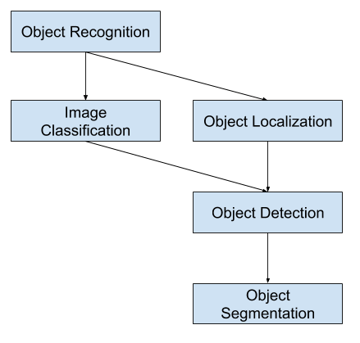
Object Recognition overview

Slide 5
Pattern Recognition Systems
Preprocessing
Clustering
Segmentation
Feature extraction and Reduction
Classification

Slide 6
Diagram of a pattern recognition/ Classification system
Main steps
Preprocessing
Segmentation
Feature extraction
Classification
Post processing
Input
Preprocessing
Segmentation
Feature extraction
classification
Post-processing
Decision

Slide 7
Preprocessing
Outlier removal
A point that lies very far from the mean of the corresponding random variable.
Data normalization
Normalizing via the respective estimates of the mean and variance.
Linear technique that limits the range of [0, 1] or [-1, 1]
Softmax scaling
Object Smoothing

Slide 8
Preprocessing
Object Smoothing
Filtering (Gaussian, Median, Mean filtering, etc.)
Object Resizing

Slide 9
Segmentation
Segmentation
Cluster with Segmentation
Segmentation
Thresholding
Edge Detection
Region Growing
Watershed
multiscale
K-means
Mean Shift
DBSCAN
EM with GMM
Centroid-based.
Density-based.
Distribution-based.
Hierarchical.

Slide 10
Feature Extraction
Feature Extraction
Wavelet Transform
Scale invariant feature transform
Hough Transform
Feature Reduction
Independent Component Analysis (ICA)
Principal Component Analysis (PCA)
Kernel PCA

Slide 11
Classification
Supervised Classification
Unsupervised Classification
Object Based Analysis
Nearest Neighbor Classification
Support Vector Machine (SVM)
Kernel SVM

Slide 12
Detection and Classification
Segmentation + Feature Extraction + Classification:
Neural Network (NN)
Convolutional Neural Network (CNN)
Recurrent Neural Network (RNN)
Feedforward Neural Network (FNN)
R-CNN
Fast R-CNN
YOLO

